Slide 1
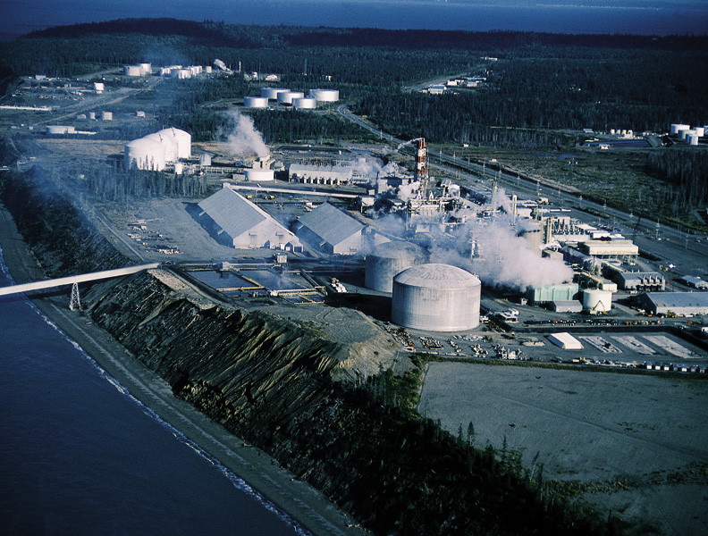
Chapter 16: Principles of Chemical Equilibrium
General Chemistry
Principles and Modern Applications
Petrucci • Harwood • Herring
8th Edition
Philip Dutton
University of Windsor, Canada
N9B 3P4
Prentice-Hall © 2002

Slide 2
Contents
16-1 Dynamic Equilibrium
16-2 The Equilibrium Constant Expression
16-3 Relationships Involving Equilibrium Constants
16-4 The Significance of the Magnitude of an Equilibrium Constant
16-5 The Reaction Quotient, Q: Predicting the Direction of a Net Change

Slide 3
Contents
16-6 Altering Equilibrium Conditions:
Le Châtelliers Principle
16-7 Equilibrium Calculations:
Some Illustrative Examples
Focus On The Nitrogen Cycle and the
Synthesis of Nitrogen Compounds

Slide 4
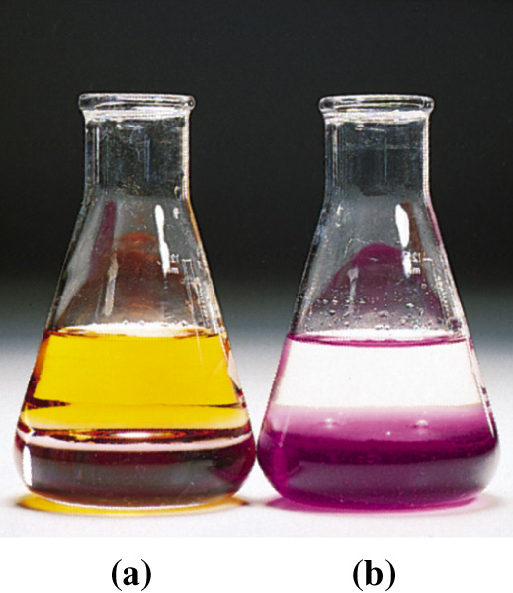
16-1 Dynamic Equilibrium
Equilibrium – two opposing processes taking place at equal rates.
H₂O(l)  H₂O(g)
H₂O
I₂(H₂O)  I₂(CCl₄)
NaCl(s)  NaCl(aq)
CO(g) + 2 H₂(g)  CH₃OH(g)

Slide 5
16-2 The Equilibrium Constant Expression
Forward:
k₁
CO(g) + 2 H₂(g) → CH₃OH(g)
R_{fwrd} = k₁[CO][H₂]²
Reverse:
k₋₁
CH₃OH(g) → CO(g) + 2 H₂(g)
R_{rvrs} = k₋₁[CH₃OH]
At Equilibrium:
k₁
R_{fwrd} = R_{rvrs}
CO(g) + 2 H₂(g)  CH₃OH(g)
k₋₁
k₁[CO][H₂]² = k₋₁[CH₃OH]
k₁
[CH₃OH]
=
= K_{c}
k₋₁
[CO][H₂]²

Slide 6
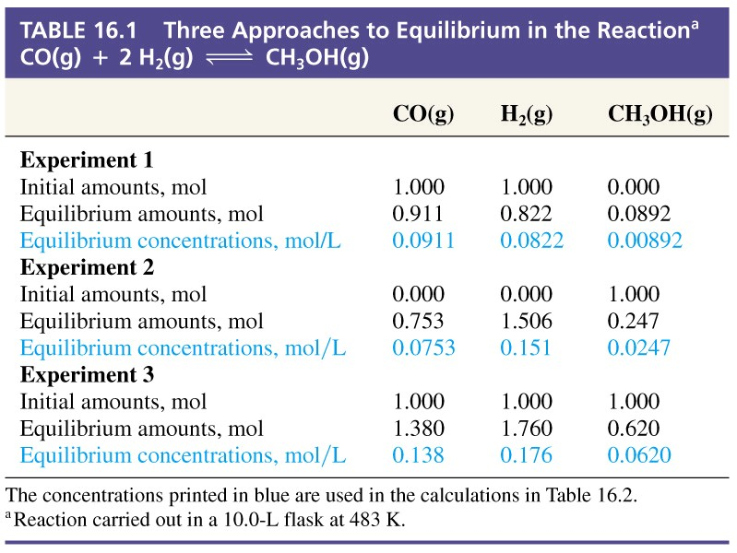
Three Approaches to Equilibrium

Slide 7
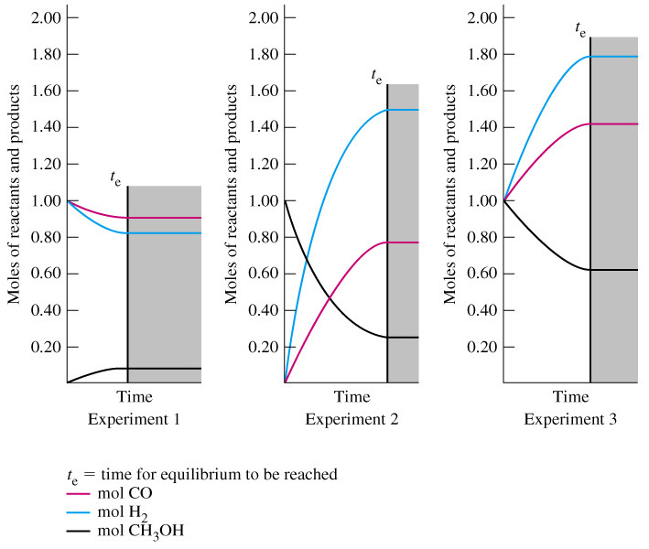
Three Approaches to the Equilibrium
Notes:
The relative levels of components of the reaction appear unrelated. See next slide for relationship.

Slide 8
Three Approaches to Equilibrium
k₁
CO(g) + 2 H₂(g)  CH₃OH(g)
k₋₁
[CH₃OH]
[CH₃OH]
[CH₃OH]
K_{c} =
[CO][H₂]
[CO](2[H₂])
[CO][H₂]²
K_{c(1)} =
1.19 M⁻¹
0.596 M⁻¹
14.2 M⁻²
K_{c(2)} =
2.17 M⁻¹
1.09 M⁻¹
14.2 M⁻²
K_{c(3)} =
2.55 M⁻¹
1.28 M⁻¹
14.2 M⁻²

Slide 9
General Expressions
a A + b B …. → g G + h H ….
[G]^{g}[H]^{h ….}
Equilibrium constant = K_{c}=
[A]^{m}[B]^{n ….}
Thermodynamic
Equilibrium constant = K_{eq}=
(a_{G})^{g}(a_{H})^{h ….}
(a_{A})ª(a_{B})^{b ….}
[B]
a_{B} =
= γ_{B}[B]
c_{B}⁰ is a standard reference state
= 1 mol L⁻¹ (ideal conditions)
c_{B}⁰
Notes:
K_{c} is based upon molar concentrations and has units.
K_{eq} is based upon activities and is unitless.
Ideal conditions are low pressures and low concentrations.

Slide 10
16-3 Relationships Involving the Equilibrium Constant
Reversing an equation causes inversion of K.
Multiplying by coefficients by a common factor raises the equilibrium constant to the corresponding power.
Dividing the coefficients by a common factor causes the equilibrium constant to be taken to that root.

Slide 11
Combining Equilibrium Constant Expressions
N₂O(g) + ½O₂  2 NO(g) K_{c}= ?
[N₂O]
N₂(g) + ½O₂  N₂O(g) K_{c(2)}= 2.710⁺¹⁸
=
[N₂][O₂]^{½}
[NO]²
N₂(g) + O₂  2 NO(g) K_{c(3)}= 4.710⁻³¹
=
[N₂][O₂]
[NO]²
[NO]²
[N₂][O₂]^{½}
1
K_{c}=
=
K_{c(3)}
=
= 1.710⁻¹³
[N₂O][O₂]^{½}
[N₂][O₂]
[N₂O]
K_{c(2)}

Slide 12
Gases: The Equilibrium Constant, K_{P}
Mixtures of gases are solutions just as liquids are.
Use K_{P}, based upon partial pressures of gases.
[SO₃]²
2 SO₂(g) + O₂(g)  2 SO₃(g)
K_{c} =
[SO₂]²[O₂]
n_{SO3}
P_{SO3}
n_{SO2}
P_{SO2}
[SO₃]=
=
[SO₂]=
=
V
RT
V
RT
n_{O2}
P_{O2}
[O₂] =
=
V
RT

Slide 13
The Equilibrium Constant, K_{P}
2 SO₂(g) + O₂(g)  2 SO₃(g)
P_{SO3}
²
[SO₃]
²
RT
P_{SO3}
K_{c} =
=
=
RT
[SO₂]²[O₂]
P_{SO2}
²
P_{O2}
P_{SO2}
P_{O2}
²
RT
RT
K_{c} = K_{P}(RT)
K_{P} = K_{c}(RT)⁻¹
K_{P} = K_{c}(RT)^{Δn}

Slide 14
Pure Liquids and Solids
Equilibrium constant expressions do not contain concentration terms for solid or liquid phases of a single component (that is, pure solids or liquids).
C(s) + H₂O(g)  CO(g) + H₂(g)
[CO][H₂]
P_{CO}P_{H2}
K_{c} =
=
(RT)¹
[H₂O]²
P_{H2O}²

Slide 15
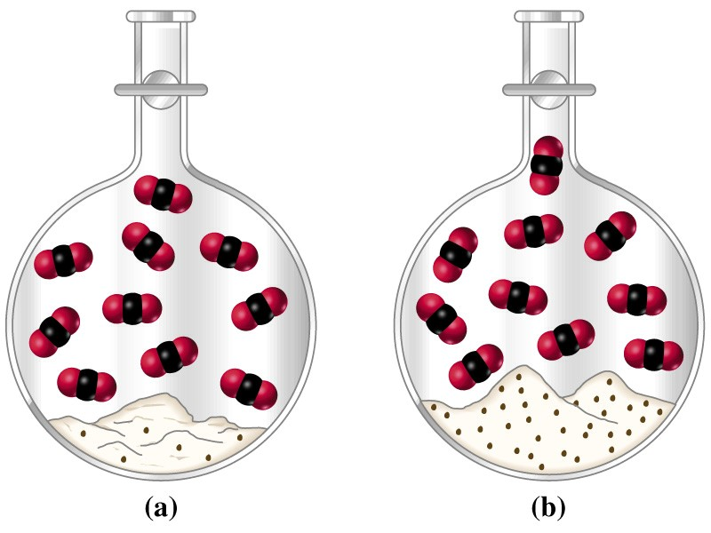
Burnt Lime
CaCO₃(s)  CaO(s) + CO₂(g)
K_{c} = [CO₂]
K_{P} = P_{CO2}(RT)
Notes:
K is independent of the amount of CaCO₃ or CaO in the flask, as long as there is some of each present.

Slide 16
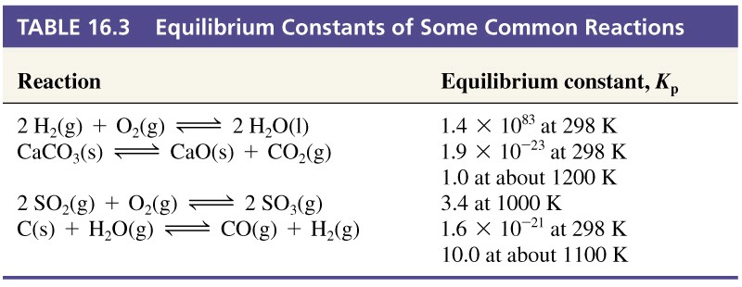
16-4 The Significance of the Magnitude of the Equilibrium Constant.
Notes:
K_{P} is linearly dependent of temperature.
1000 C in a lime kiln at a pulp mill. CO₂ is driven off and Le Chatellier’s principle is operative.

Slide 17
16-5 The Reaction Quotient, Q: Predicting the Direction of Net Change.
k₁
CO(g) + 2 H₂(g)  CH₃OH(g)
k₋₁
Equilibrium can be approached various ways.
Qualitative determination of change of initial conditions as equilibrium is approached is needed.
[G]_{t}^{g}[H]_{t}^{h}
Q_{c} =
At equilibrium Q_{c} = K_{c}
[A]_{t}^{m}[B]_{t}^{n}

Slide 18
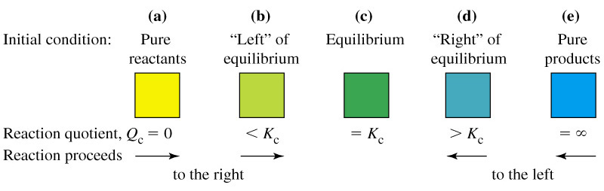
Reaction Quotient

Slide 19
16-6 Altering Equilibrium Conditions:
Le Châtellier’s Principle
When an equilibrium system is subjected to a change in temperature, pressure, or concentration of a reacting species, the system responds by attaining a new equilibrium that partially offsets the impact of the change.

Slide 20
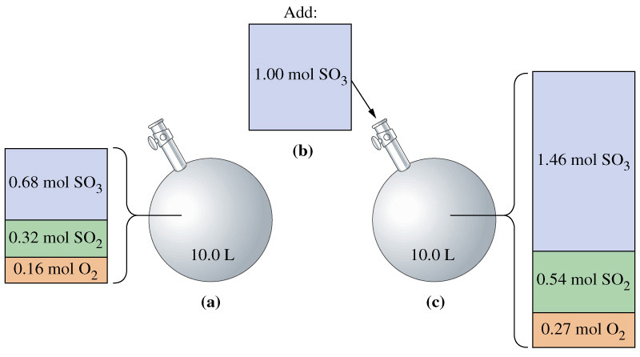
Le Châtellier’s Principle
k₁
2 SO₂(g) + O₂(g)  2 SO₃(g)
K_{c} = 2.810² at 1000K
k₋₁
[SO₃]²
Q =
= K_{c}
Q > K_{c}
[SO₂]²[O₂]

Slide 21
Effect of Condition Changes
Adding a gaseous reactant or product changes P_{gas}.
Adding an inert gas changes the total pressure.
  Relative partial pressures are unchanged.
Changing the volume of the system causes a change in the equilibrium position.
n_{SO3}
²
[SO₃]
²
V
n_{SO3}
K_{c} =
=
=
V
[SO₂]²[O₂]
n_{SO2}
²
n_{O2}
n_{SO2}
n_{O2}
²
V
V

Slide 22
Effect of change in volume
[G]^{g}[H]^{h}
n_{G}
n_{H}
^{g}
^{h}
K_{c} =
=
V^{(a+b)-(g+h)}
[C]^{c}[D]^{d}
n_{A}
n_{B}
ª
ª
n_{G}
n_{H}
^{g}
^{h}
=
V^{-Δn}
n_{A}
n_{B}
ª
ª
When the volume of an equilibrium mixture of gases is reduced, a net change occurs in the direction that produces fewer moles of gas. When the volume is increased, a net change occurs in the direction that produces more moles of gas.

Slide 23
Effect of Temperature on Equilibrium
Raising the temperature of an equilibrium mixture shifts the equilibrium condition in the direction of the endothermic reaction.
Lowering the temperature causes a shift in the direction of the exothermic reaction.

Slide 24
Effect of a Catalyst on Equilibrium
A catalyist changes the mechanism of a reaction to one with a lower activation energy.
A catalyst has no effect on the condition of equilibrium.
  But does affect the rate at which equilibrium is attained.

Slide 25
16-7 Equilibrium Calculations:
Some Illustrative Examples.
Five numerical examples are given in the text that illustrate ideas that have been presented in this chapter.
Refer to the “comments” which describe the methodology. These will help in subsequent chapters.

Slide 26
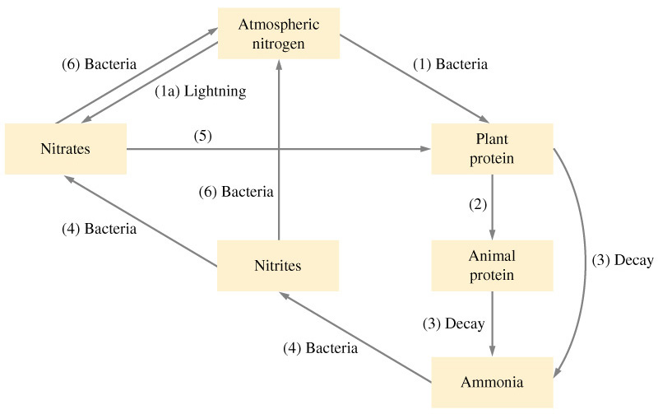

Focus on the Nitrogen Cycle and the Synthesis of Nitrogen Compounds.
k₁
K_{P} = 4.7 10⁻³¹ at 298K and 1.3 x 10⁻⁴ at 1800K
N₂(g) + O₂(g)  NO(g)
k₋₁

Slide 27
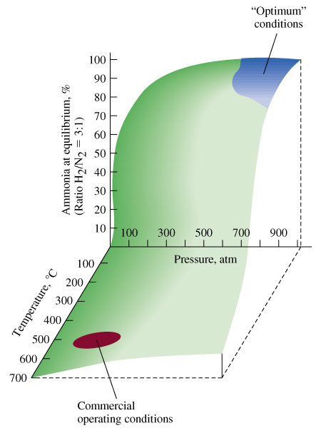
Synthesis of Ammonia
The optimum conditions are only for the equilibrium position and do not take into account the rate at which equilibrium is attained.

Slide 28
Chapter 16 Questions
Develop problem solving skills and base your strategy not on solutions to specific problems but on understanding.
Choose a variety of problems from the text as examples.
Practice good techniques and get coaching from people who have been here before.

